Slide 1

Deep Learning Classification for Lung Cancer Diagnosis
Capstone Project Presentation

Slide 2

Biography
Koh Shao Ming
Nanyang Technology University
Bachelor’s Design in Mechanical Engineering
Interest in algorithms and optimisation theory
Fresh graduate from Institute of Data

Slide 3

Content
Project Overview
Data Exploration
Sampling methods for Imbalanced Classes
Deep Learning Model
Conclusion
Future work

Slide 4
Project Overview

Slide 5
Background
What is Lung Cancer?
Lung cancer is the uncontrolled growth of abnormal cells in one or both lungs, usually in the cells lining air passages. These abnormal cells do not grow into healthy lung tissue but divide rapidly to form tumors that interfere with lung function.
2nd most common cancer in Men
3rd most common cancer in Women
Risk developing lung cancer is 3 times higher in men as compared to women.
Source: https://www.gleneagles.com.sg/facilities-services/centre-excellence/cancer-care/lung-cancer

Slide 6
Business Problem
Due to rapid increase in Covid-19 cases, most of the manpower in the hospital is allocated to deal with patients with critical conditions.
Busy doctors
There is a need to reduce the time to diagnose patients having potential lung cancer
Lung cancer needs to be detected and treated as early as possible to reduce the risk of death.

Slide 7
Business Goal
To automate the diagnosis process of lung cancer in computed tomography (CT) scan images.
This is a Tier 1 Diagnosis Process is to identify Malignant cases
Data Goal
To build a machine learning model to classify CT scan images into 3 classes: normal, benign, and malignant
Main Objective is to have Recall score of Malignant cases at least 95%
Benign (non-cancerous); Malignant (cancerous)

Slide 8
Stakeholder
Doctors
Hospital management
Data Scientist
Patients
Radiology technologist

Slide 9
Data Exploration

Slide 10
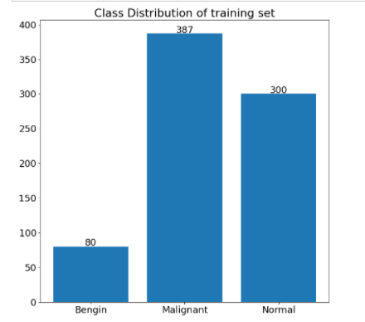
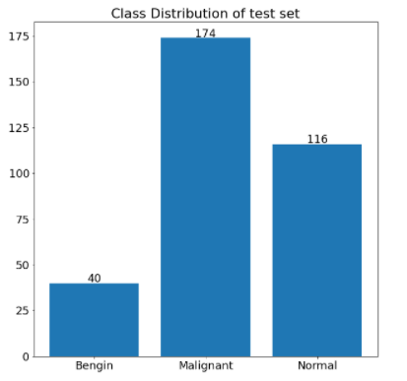
Dataset
Total of 1,097 CT scan images with 3 Classes: Benign, and Malignant, Normal
110 patients:
15 Benign
40 Malignant
55 Normal
Different angles of CT scans are done on each patient
Source: https://www.kaggle.com/adityamahimkar/iqothnccd-lung-cancer-dataset

Slide 11
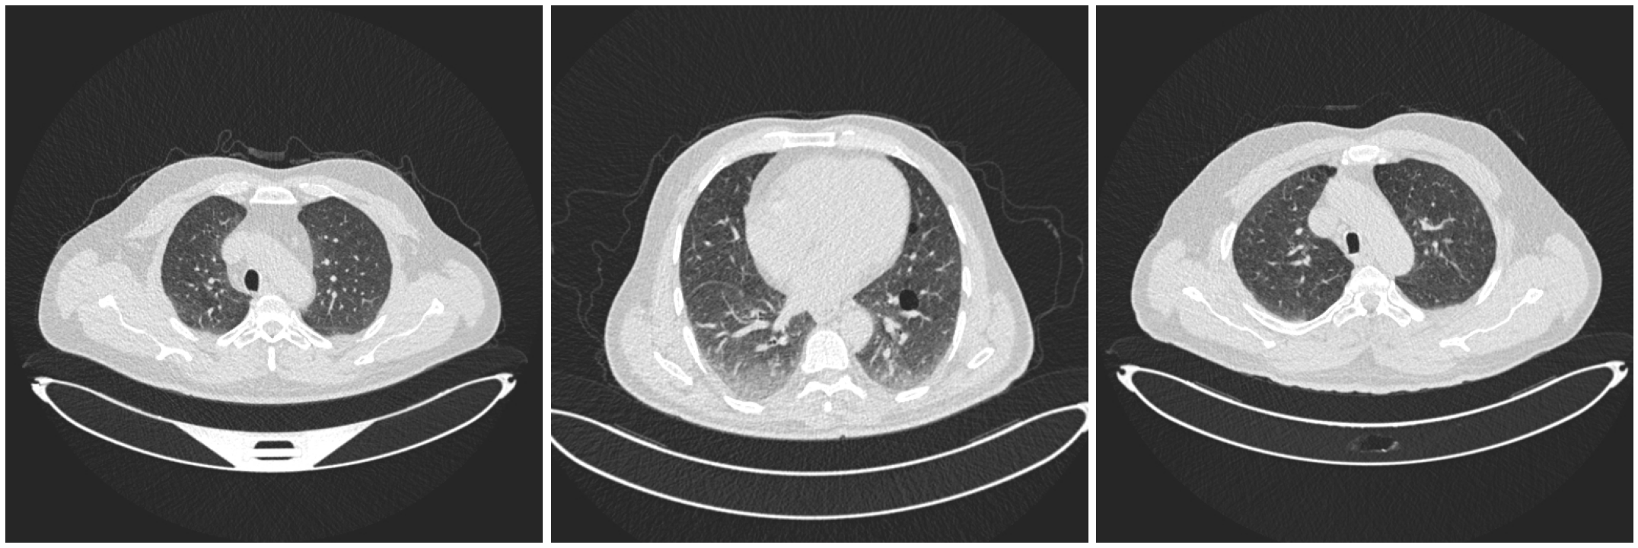
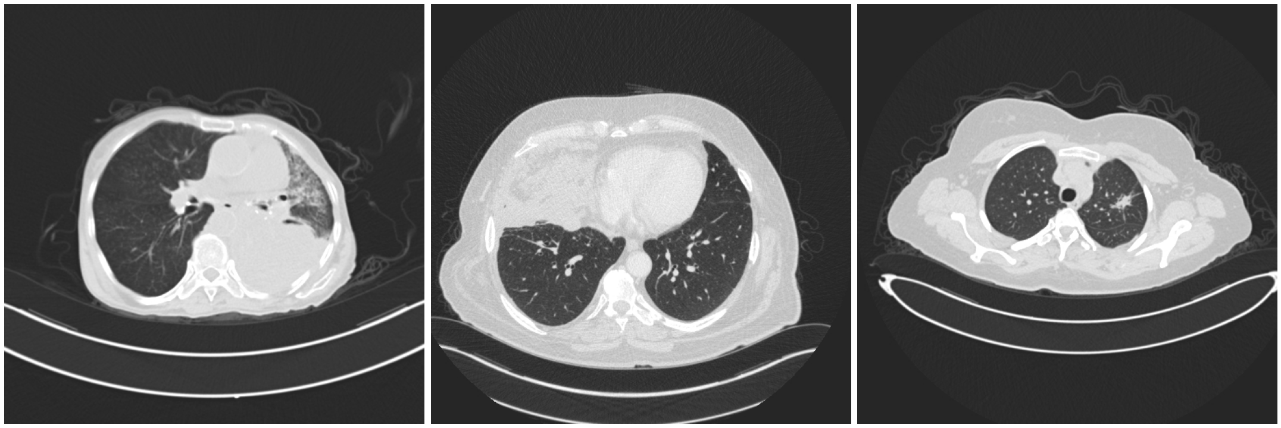
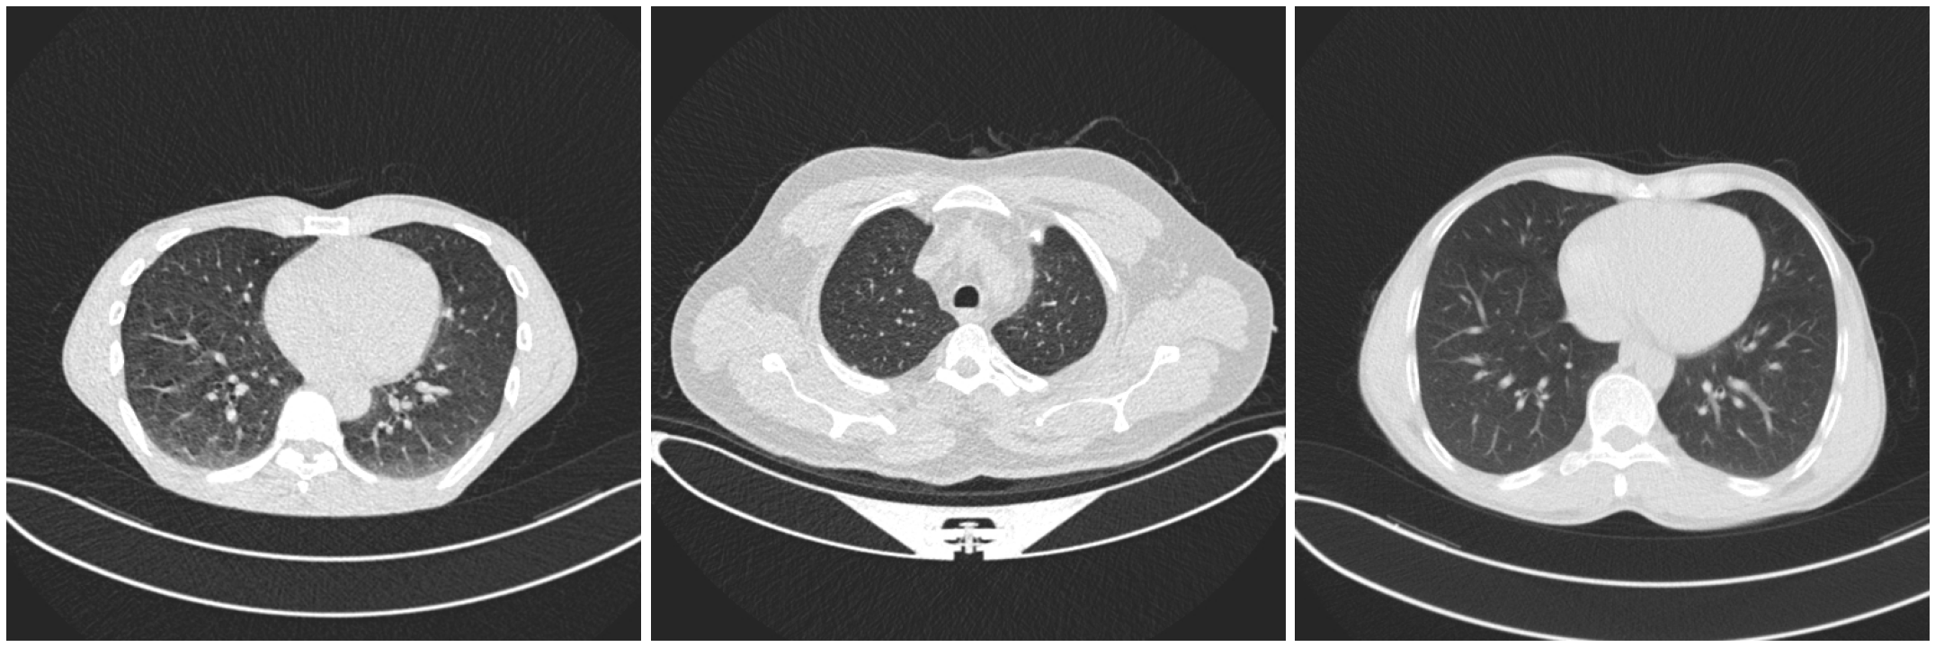
Example of CT images
Benign
Malignant
Normal

Slide 12
Sampling Techniques

Slide 13
Sampling Techniques
Weighted Class Approach
Data Augmentation for Minority Class
Synthetic Minority Over-sampling Technique (SMOTE)

Slide 14
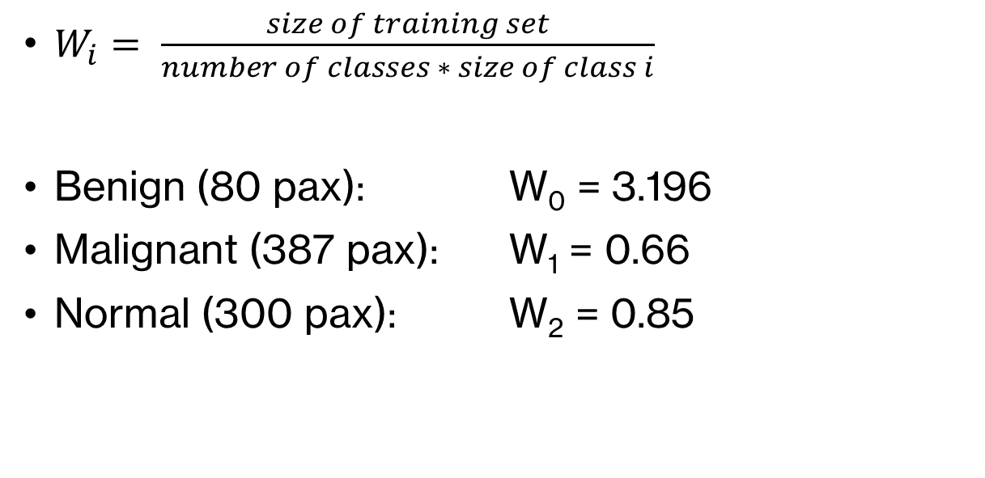
Weighted Class
$W_{i}= \frac{size of training set}{number of classes ∗ size of class i}$
Benign (80 pax): W₀ = 3.196
Malignant (387 pax): W₁ = 0.66
Normal (300 pax): W₂ = 0.85

Slide 15
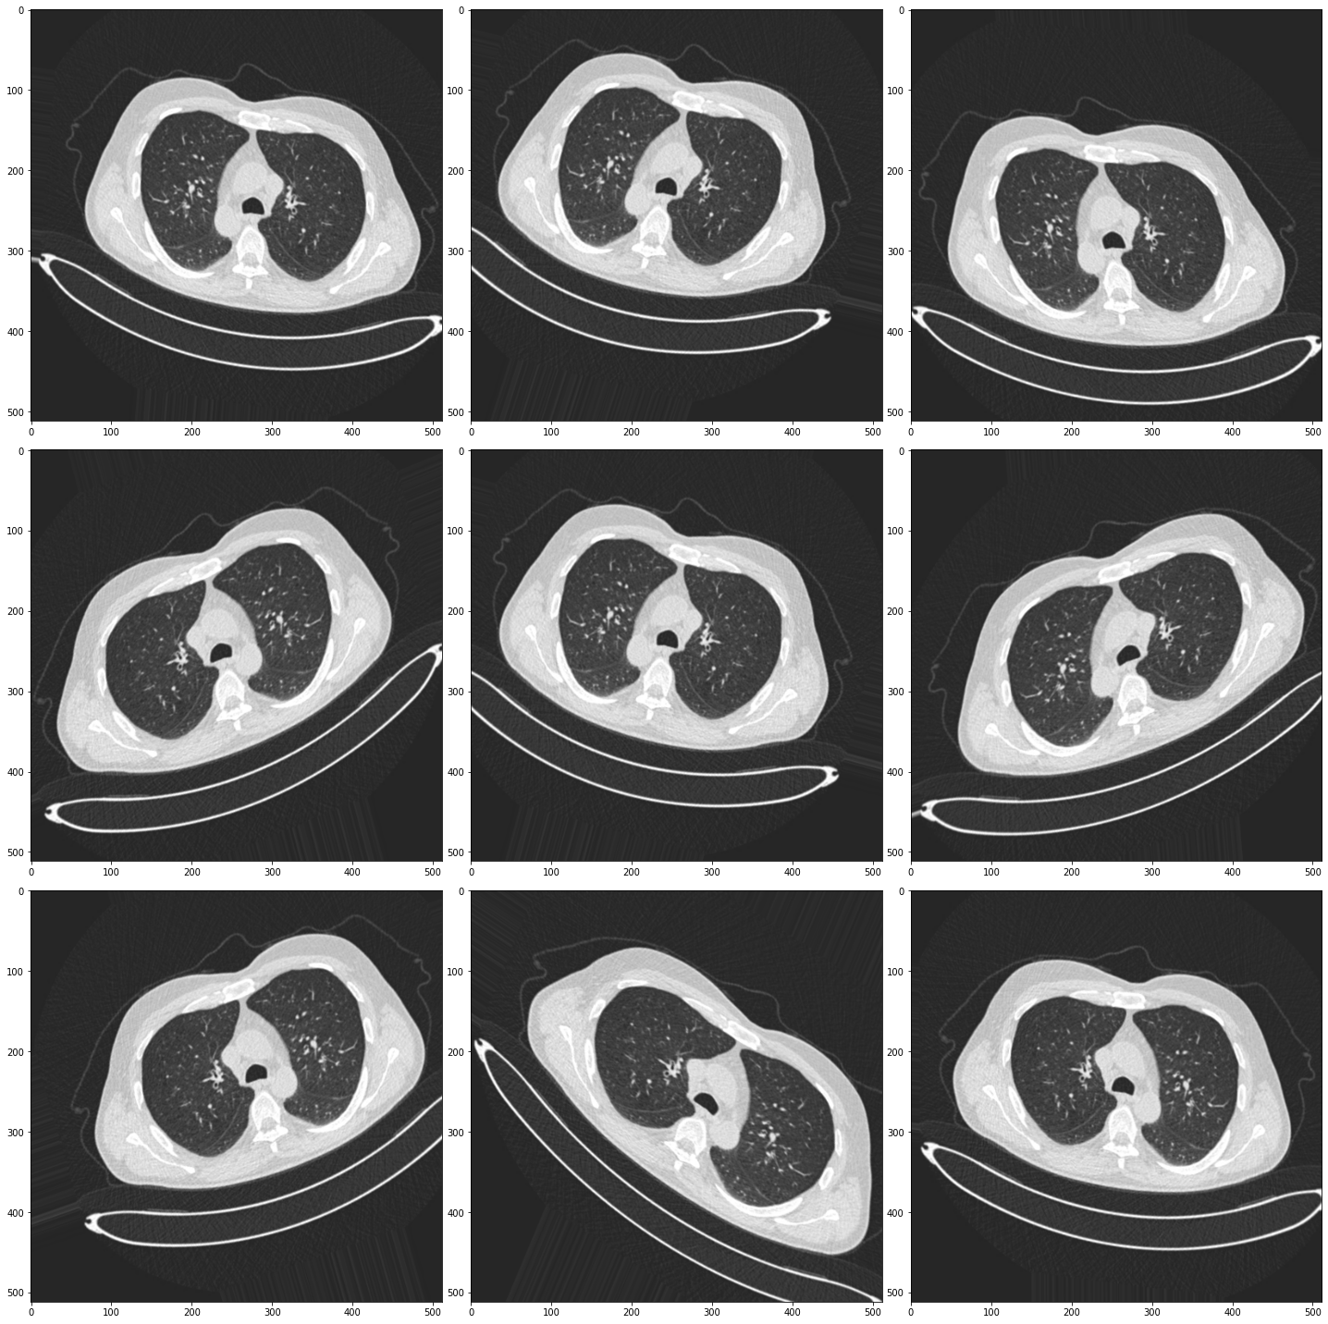
Data Augmentation
Rotation
Zoom
Vertical & horizontal flip
Width/height shift

Slide 16
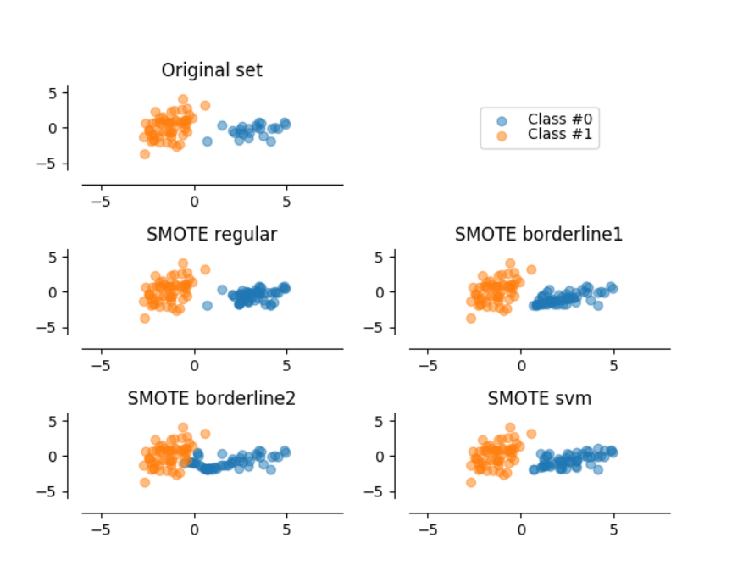
Synthetic Minority Over-sampling Technique (SMOTE)

Slide 17
Deep Learning Models

Slide 18

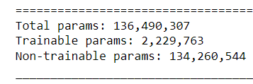
Pre-trained Model: VGG16
Why transfer learning?
Dataset is relatively small (1,097 images)
Time constraints; less time spent to do fine-tuning
1x1x512
1x1x256
1x1x3

Slide 19
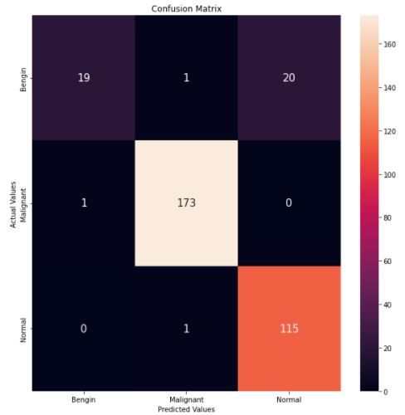
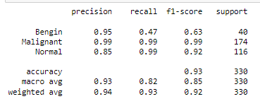
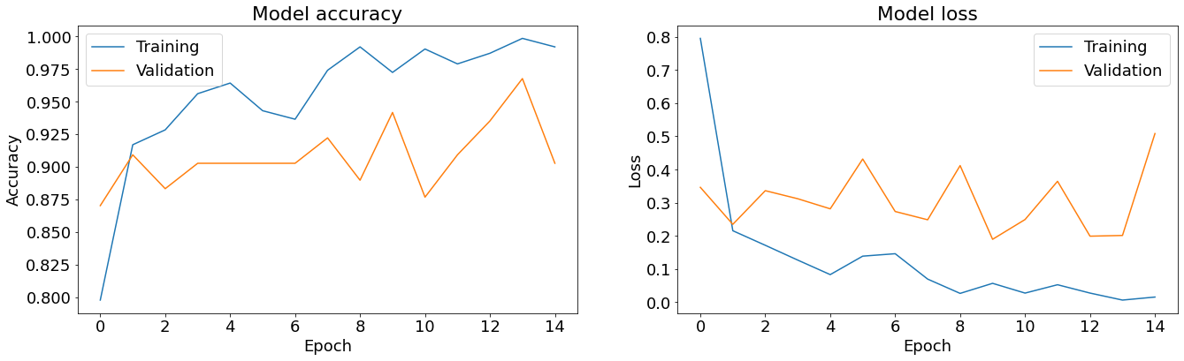
Original training set
Classification report
Actual
Predicted

Slide 20
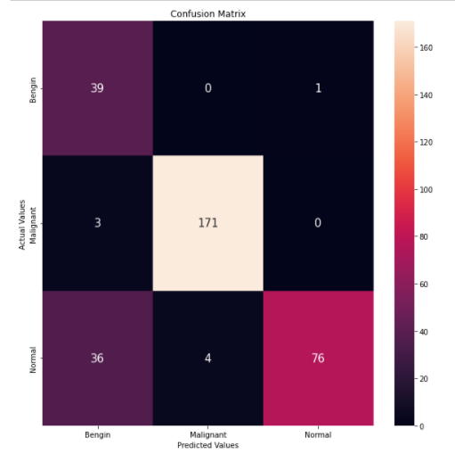
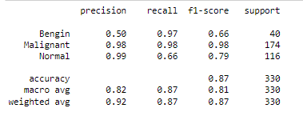
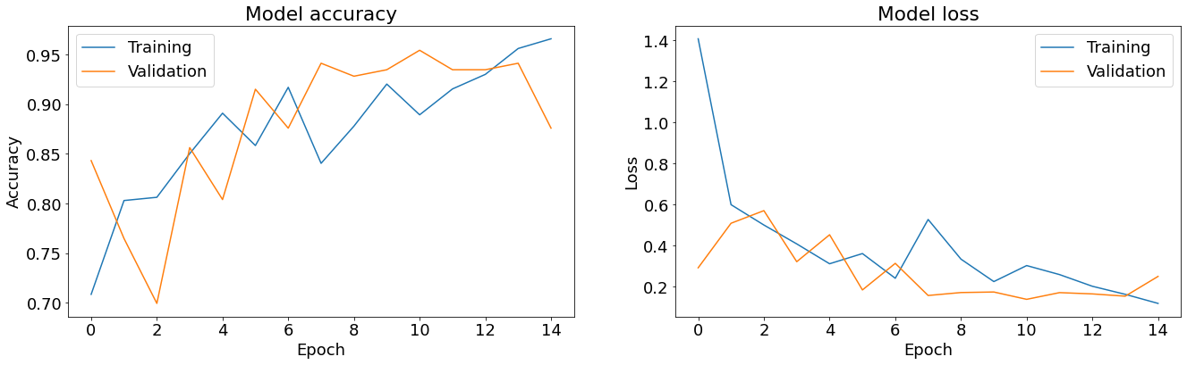
Applied Data Augmentation and Weighted Class
Classification report
Actual
Predicted

Slide 21
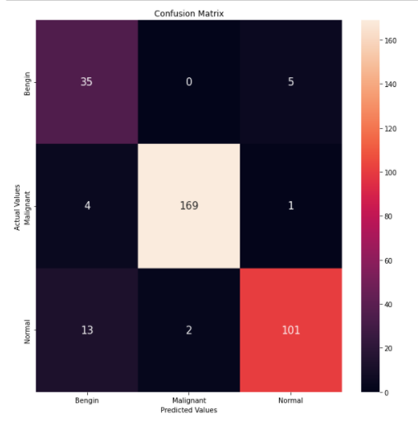
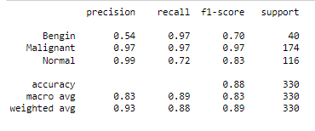
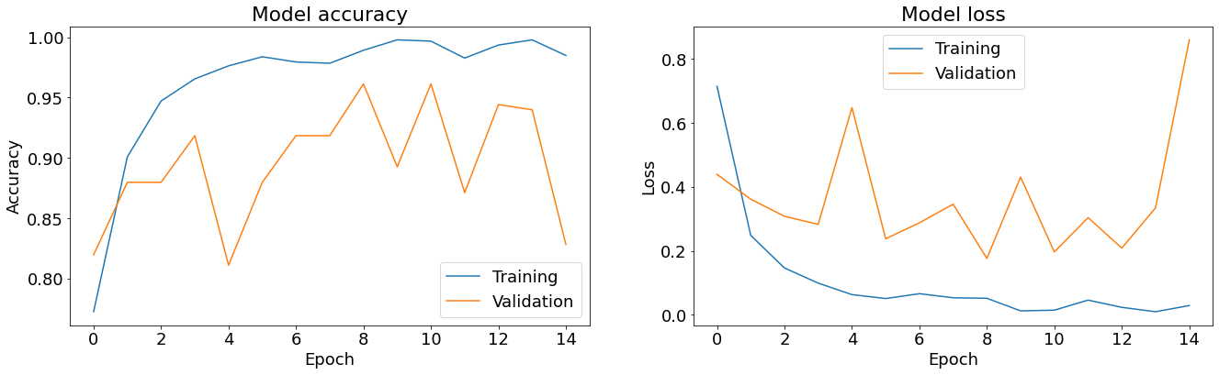
Applied SMOTE
Classification report
Actual
Predicted

Slide 22
Findings & Conclusion
Main Objective is to achieve high recall score for Malignant (99%)
Introducing sampling technique:
Reduce number of False Negative (Benign case mistreated as Normal)
Recall of Bengin: 47% to 97%
Increase number of False Positive (Normal case mistreated as Benign)
Results can be compare among the different images taken from the same patient
Results can be cross reference with other diagnosis methods
i.e. Blood tests, X-ray

Slide 23
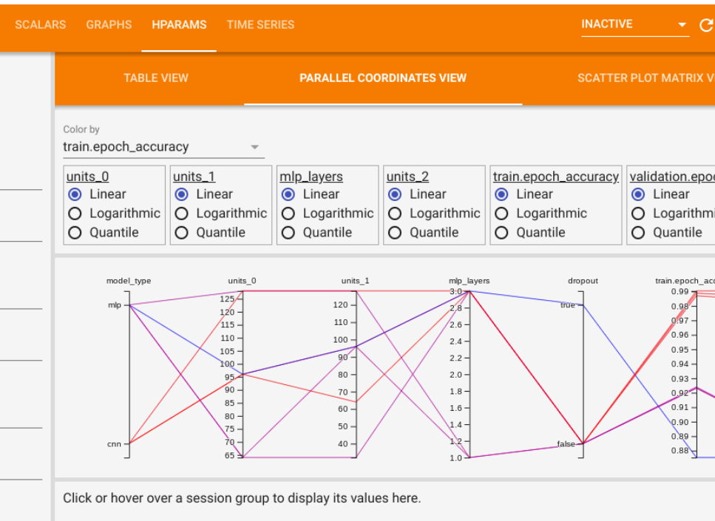
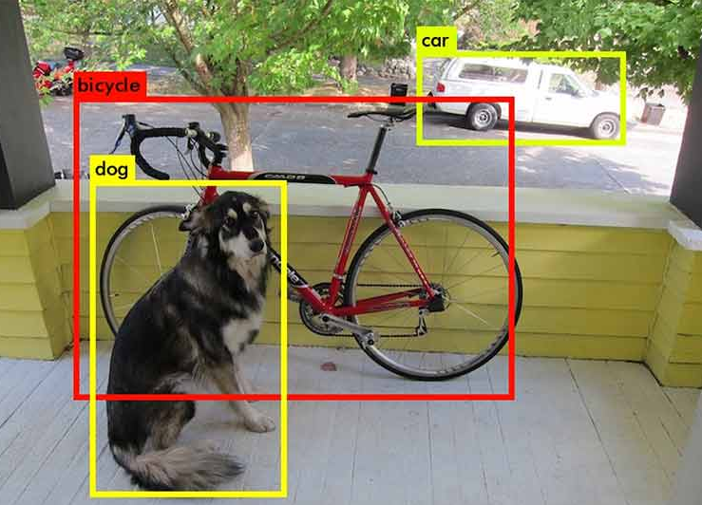
Future Work
Hyper-parameter tuning using Tensor board
Object detection to mark out tumour on the image (Image segmentation)
Gather more samples to improve the model

Slide 24

Thank you
Any Questions?

